Slide 1
Length Extension Attack
Featuring SHA-1 MACs

Slide 2
Message Authentication Code
Allows a message receiver to verify that the message has not been altered in transit.
This is accomplished through the use of a shared secret key between the sender and receiver.

Slide 3
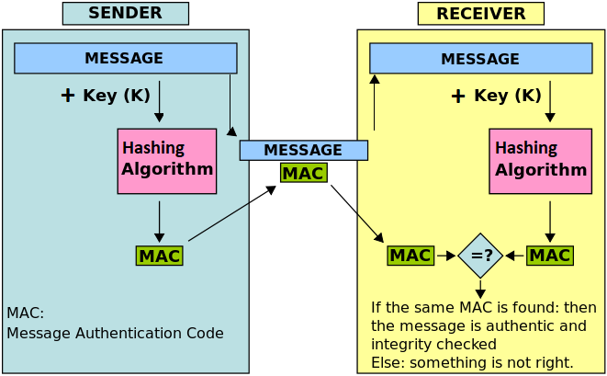

Slide 4
DEMO

Slide 5
Secure Hash Algorithm 1
Streams over the message in 512 bit blocks
The hash of each block is used as the seed for the next block
This is the crux of the vulnerability

Slide 6
Secret Key + Message
176 Bits
Total Length: 1200 Bits
512 Bits
512 Bits
Initial Seed
+
336 Bit Pad
1
2
3
SHA-1
SHA-1
SHA-1
MAC

Slide 7
SHA-1 Padding
If the last message block is less than 512 bits then padding is applied.
The padding is a single ‘1’ followed by ‘0’s until the last 64 bits which represent the character length of the entire message in binary

Slide 8
Length Extension Attack
Message Extension
The length of the original message, including the secret key, is required to determine the initial padding
+
336 Bit Pad
176 Bits
512 Bits
Pass in the MAC as the initial seed
4
5
SHA-1
SHA-1
Spoofed MAC

Slide 9
Solution? Enter HMAC
Hashed Message Authentication Code:
HMAC = hash(SECRET_KEY + MAC)
Immune to length extension attacks because the SECRET_KEY + MAC will always have a fixed length

Slide 10
HMAC DEMO

Slide 11
Other Hash Algorithms
Vulnerable:
MD5
SHA-2
Immune:
SHA-3

Slide 12
GitHub Link
https://github.com/mohagan9/LengthExtensionAttackDemo

